Slide 1
Knight's Tour using Backtracking
Anjali Haryani, Yuexin Ma, Payal Chavan, Mengyuan Liu

Slide 2
Algorithm Overview & History

Slide 3
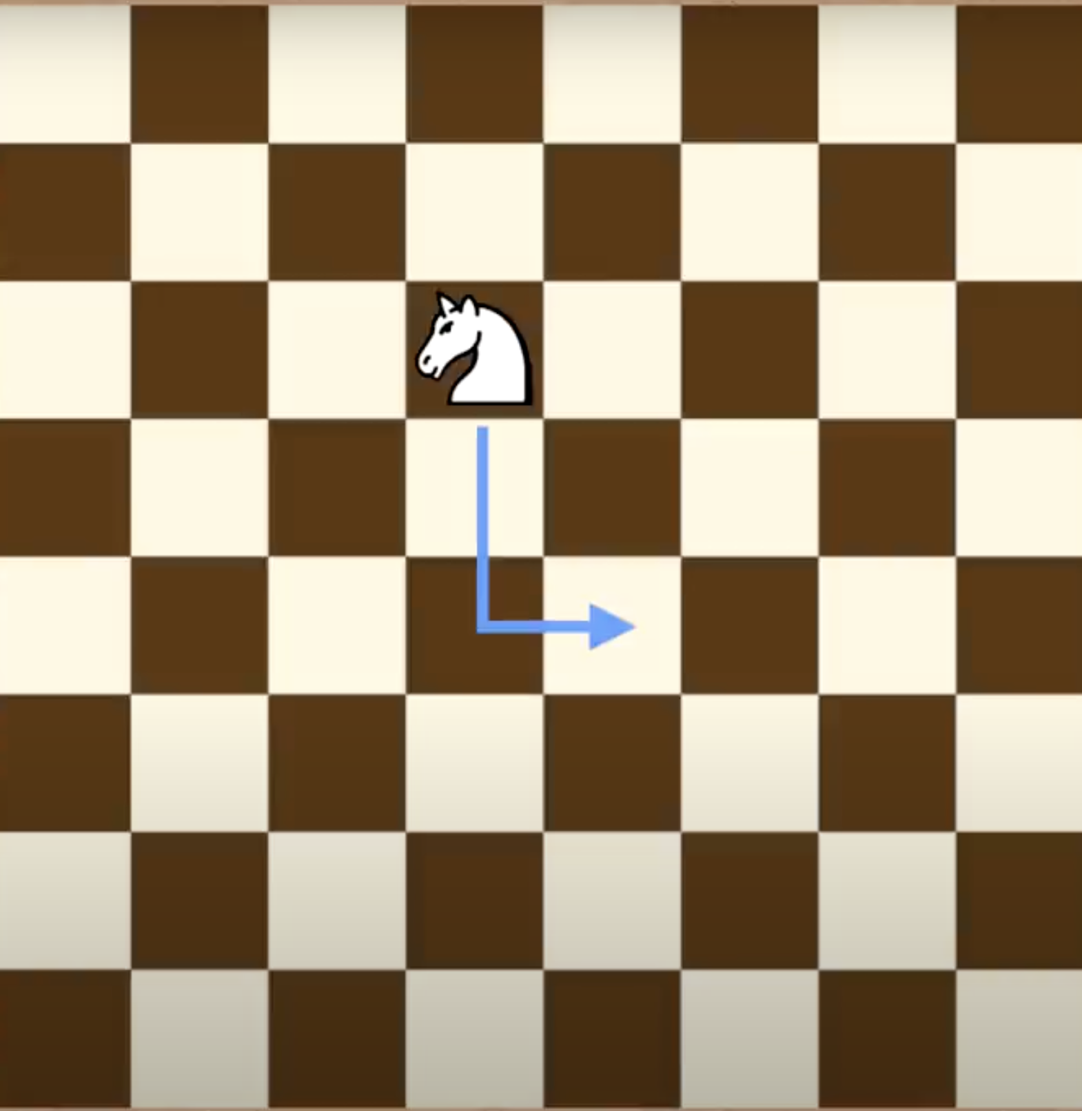
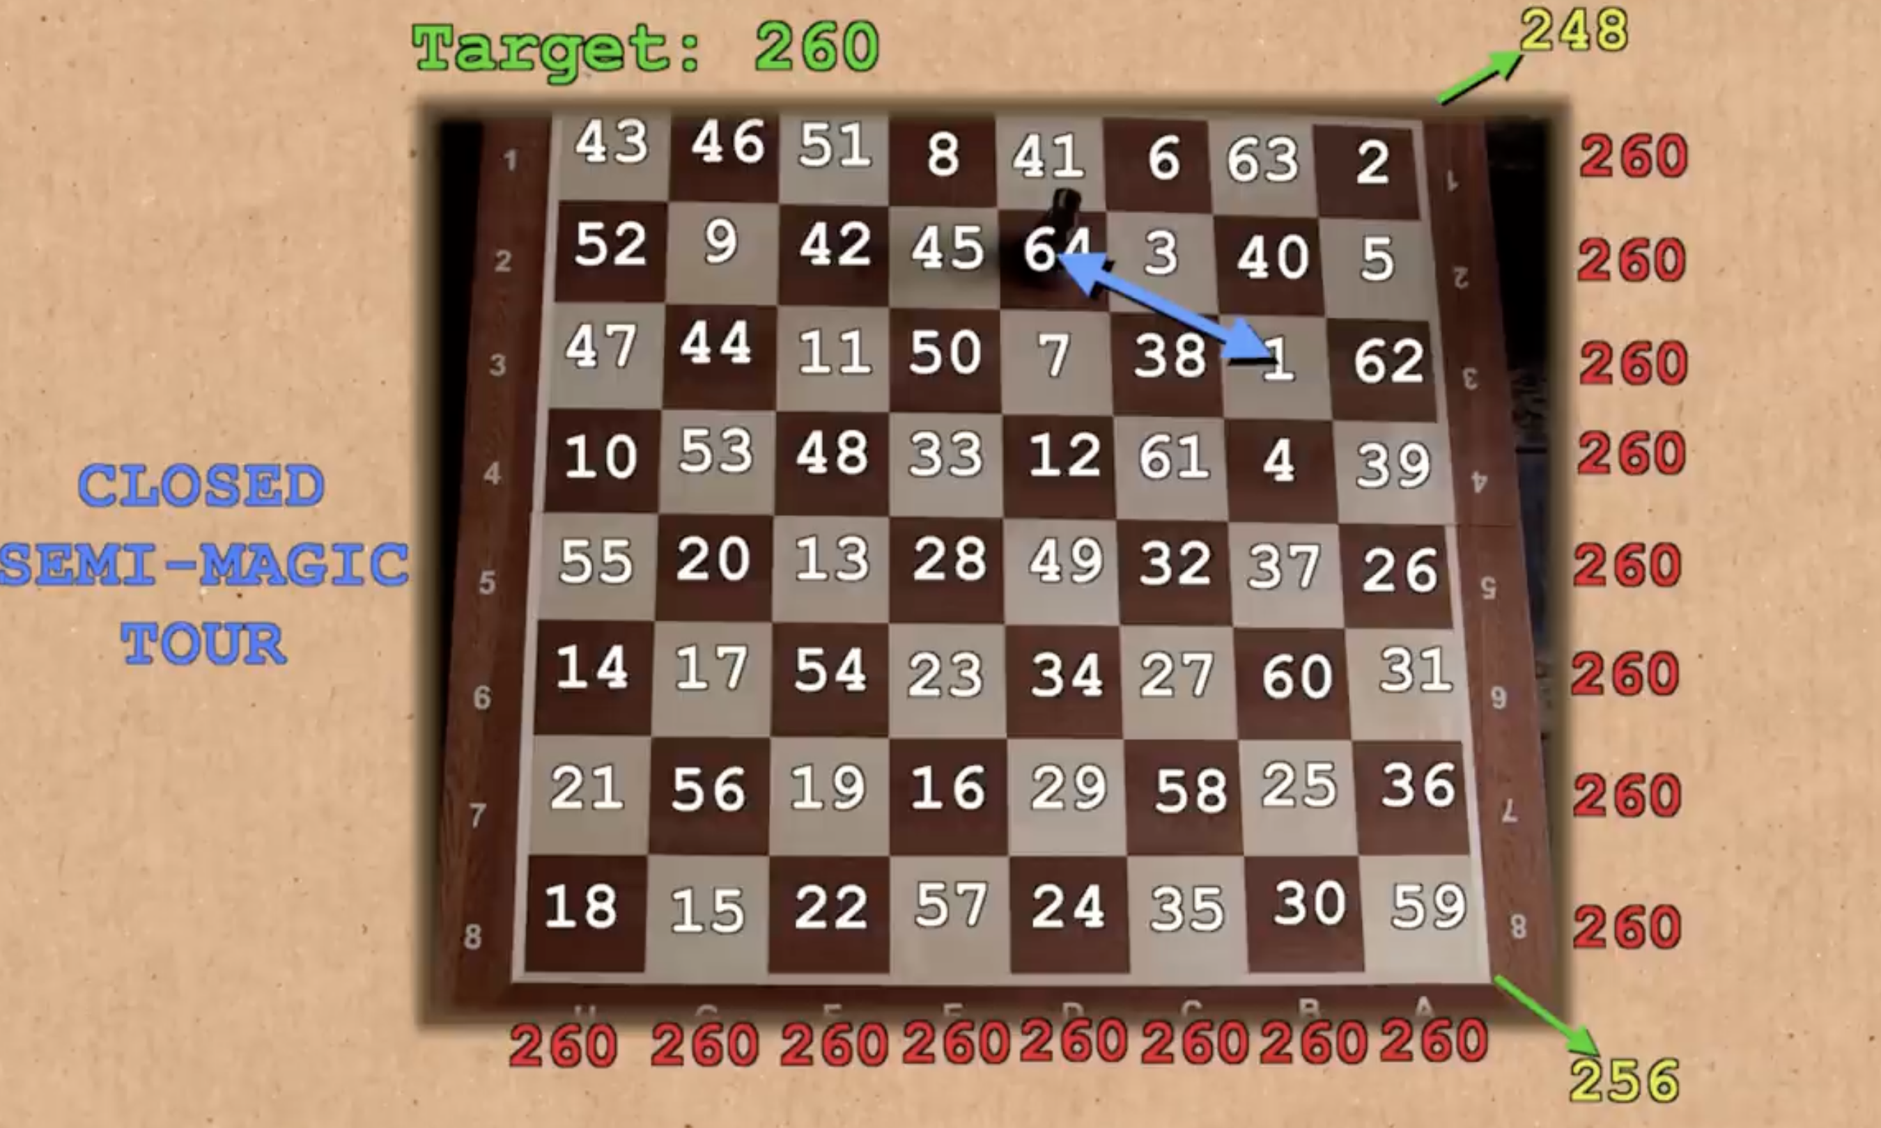

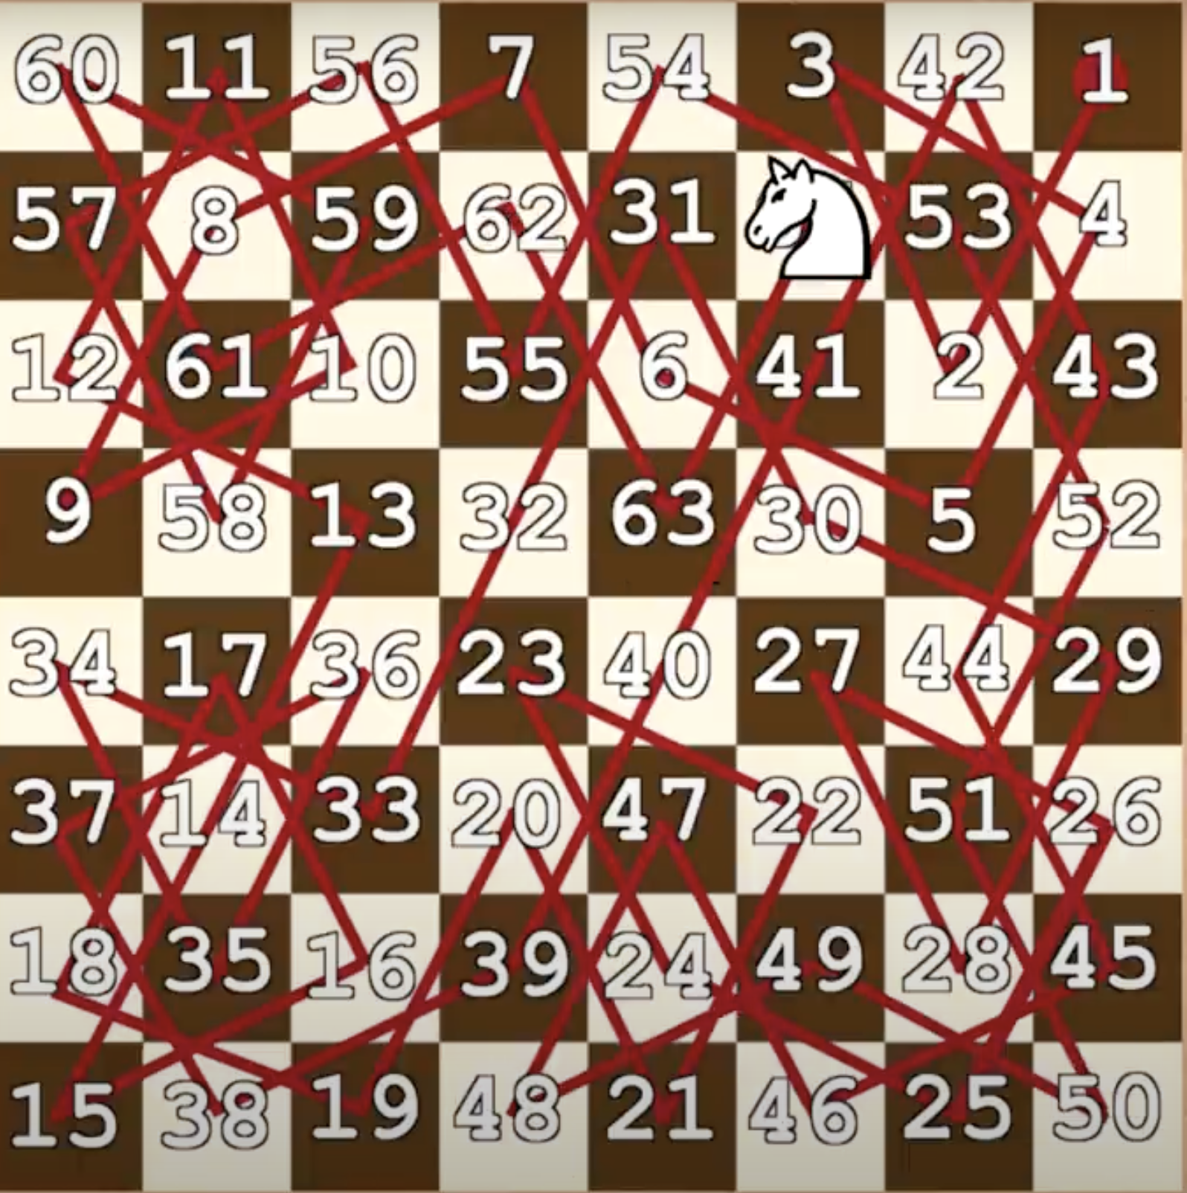
What is Knight's Tour ?
A knight can walk in an “L” shape on the chessboard, and it can travel through the board without repeating.
More interesting fact: The sum of all the columns and lines can be the same number

Slide 4
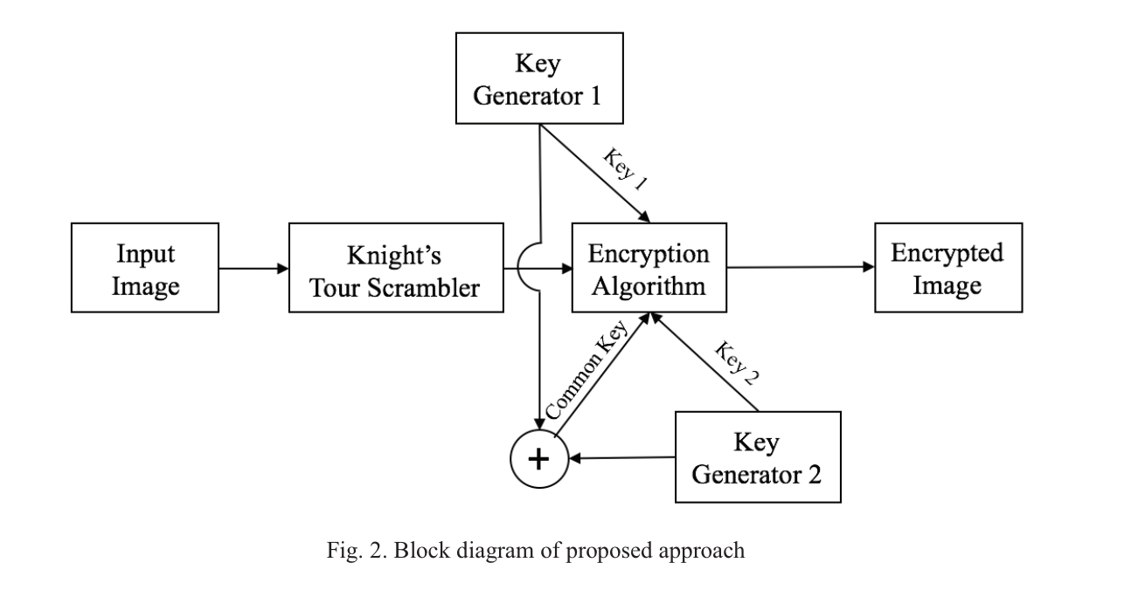
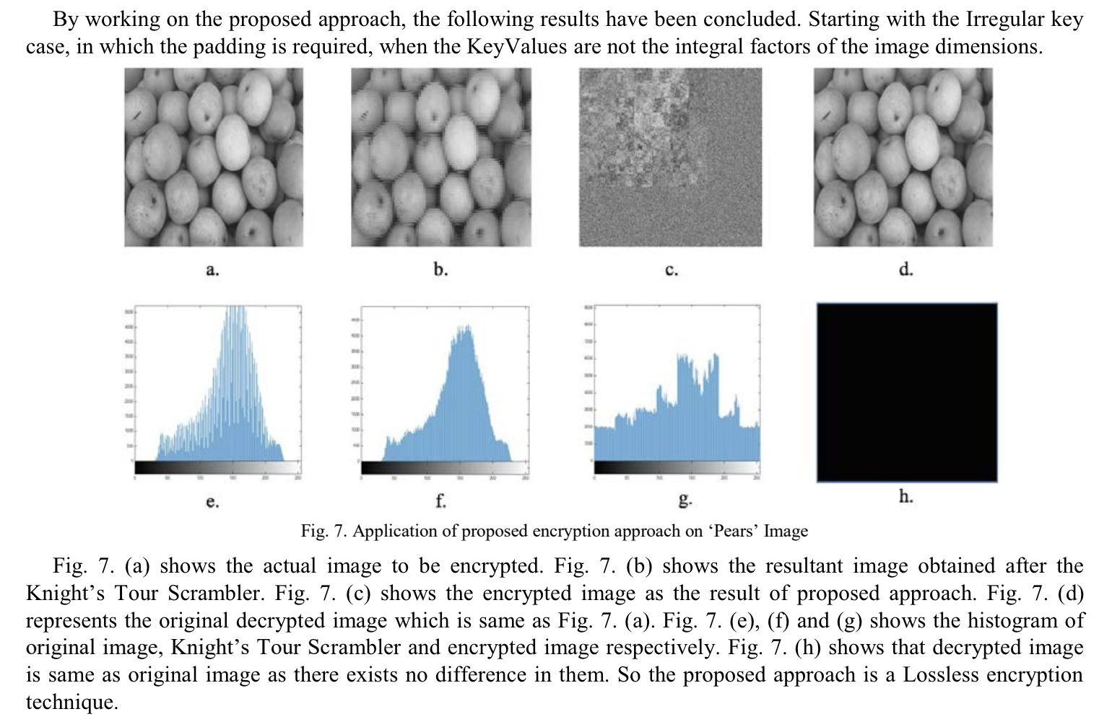
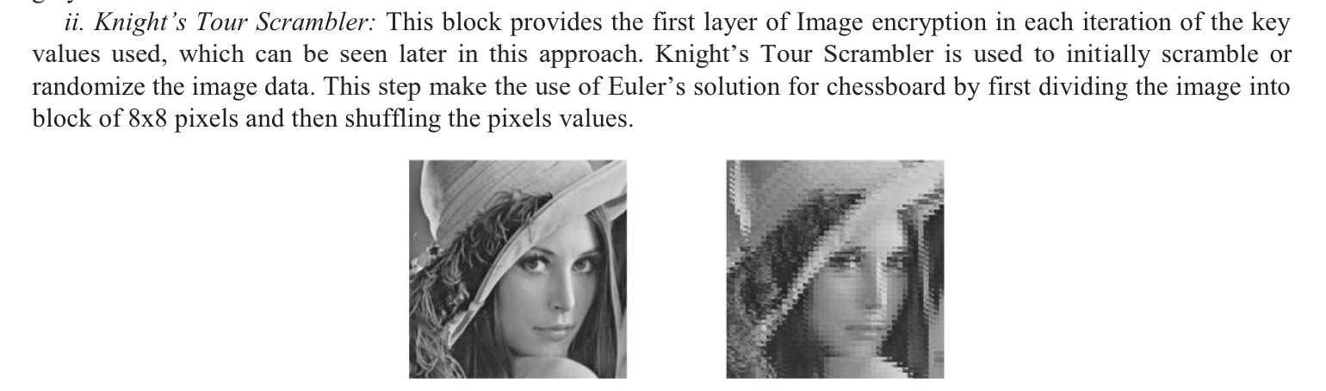
Extend for the Knight's Tour Problem
Visual cryptography by extending the Knight’s Tour Problem.
The designed methodology enhances image encryption but without the need for cover images.
It accepts numerical values as key and there is no constraint on the length of key.

Slide 5
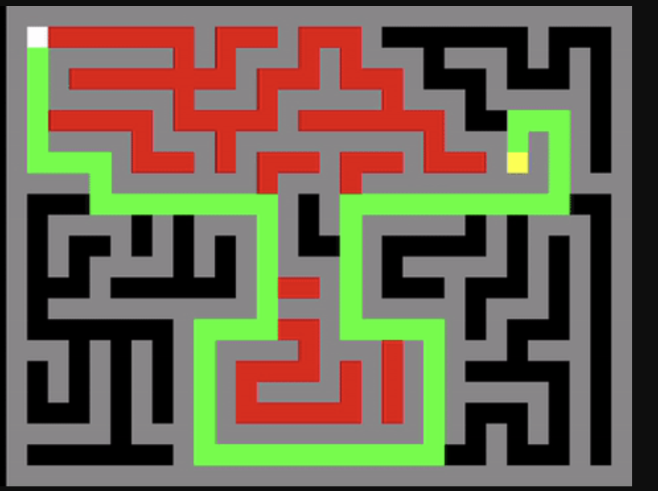
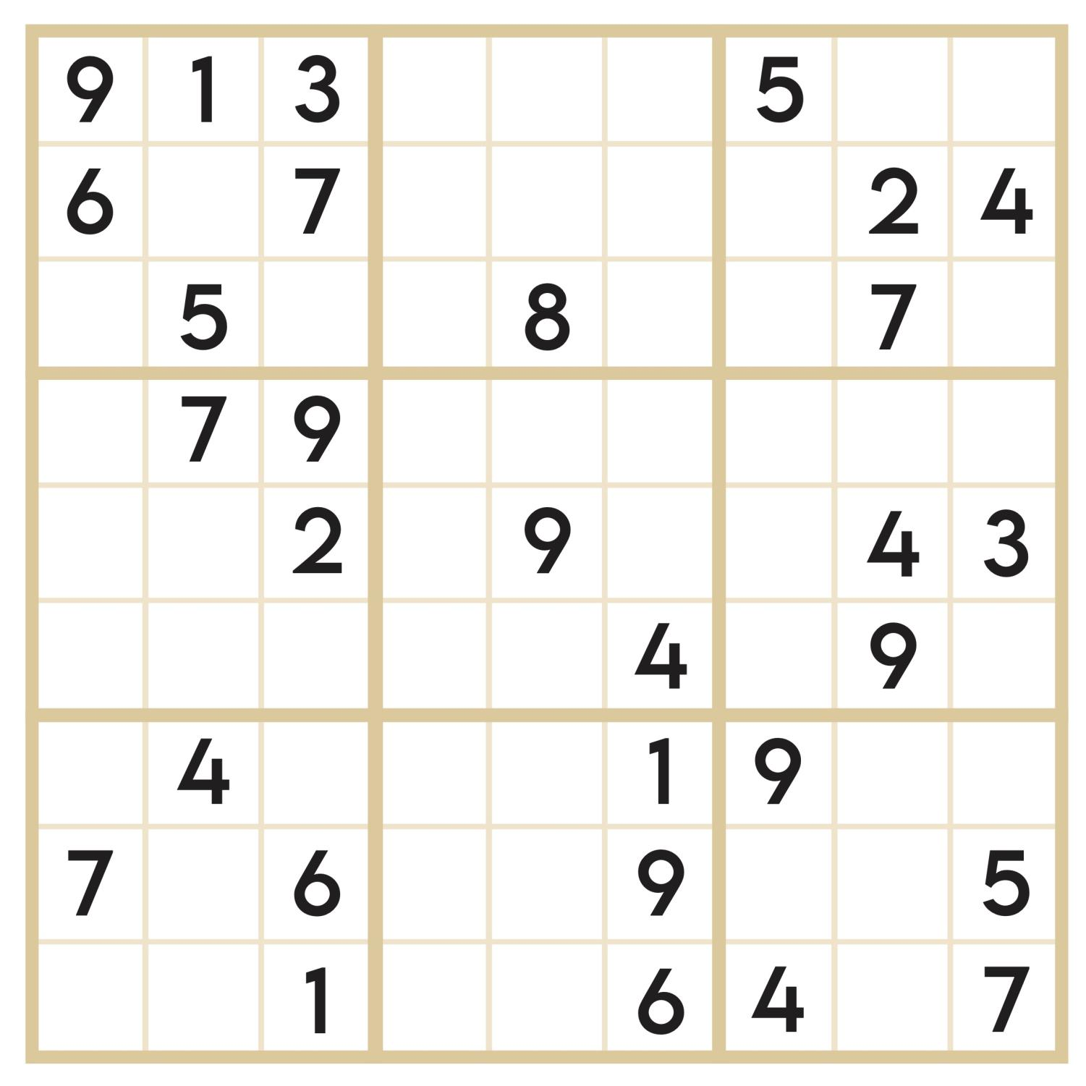
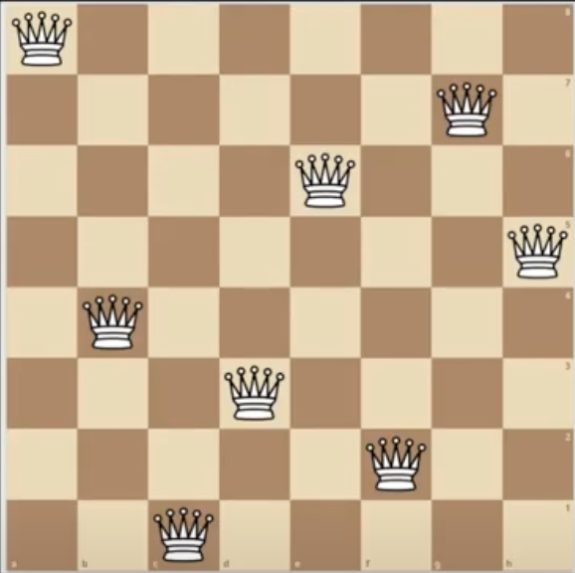
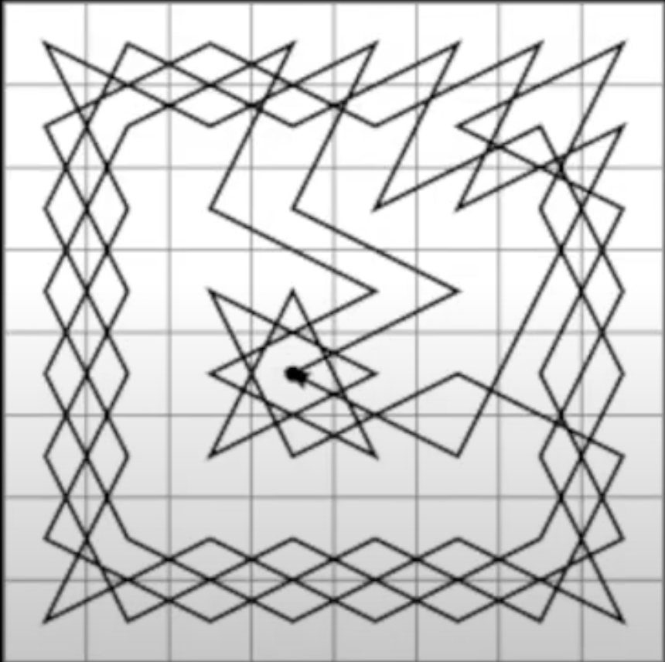
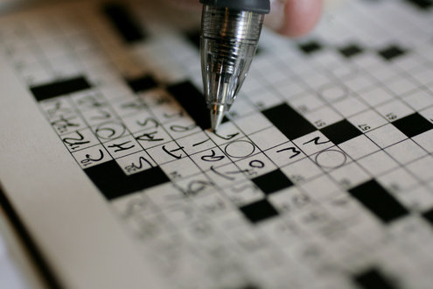
Logic behind Backtracking
Every time you come to a juncture where you have multiple paths to follow, follow the first one and see if it leads to a solution.
If it doesn’t come back and choose the next solution, which means backtracking is a recursive algorithm.
Backtracking shines in cracking puzzles like sudoku or crosswords. It's about trial and error, trying options, and eliminating paths that don't lead to a solution.
sudoku
crosswords
N-Queens
Knight's Tour

Slide 6
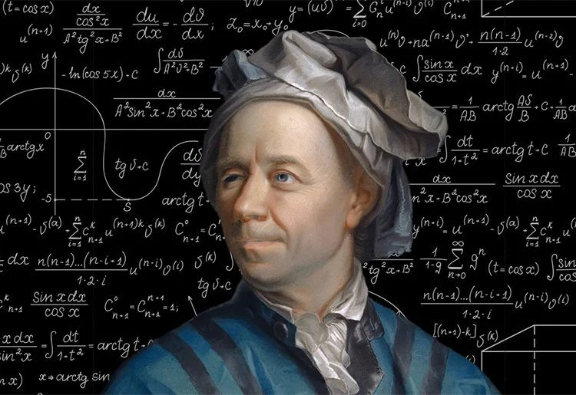
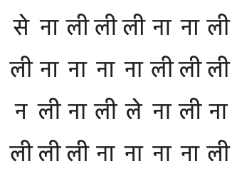
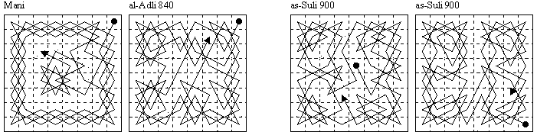
Algorithm History
Early History: ​
Originated in India during the 9th century. ​
Spread through the Persian and Arabic worlds.
Medieval and Renaissance Europe:
Gained attention from notable mathematicians like Fibonacci in the early 13th century.​
Euler’s Contribution: ​​
In the 18th century, Leonhard Euler significantly advanced the study of the Knight’s Tour by applying graph theory.​​
Modern Computational Approaches: ​​​
The advent of computers transformed the Knight’s Tour into a common challenge for testing pathfinding and backtracking algorithms.​​​
Notes:
Early History: It originated in India during the 9th century. It spread through the Persian and Arabic worlds.
the pattern of a knight's tour on a half-board has been presented as an poetic figure. This picture is an example, each syllable can be considered as representing a cell on a chessboard.
• Medieval and Renaissance Europe: The problem reached Europe by the medieval period, gaining attention from notable mathematicians like Fibonacci in the early 13th century.
• Euler’s Contribution: In the 18th century, Leonhard Euler significantly advanced the study of the Knight’s Tour by applying graph theory.
Euler's method treats the chessboard as a graph where each square represents a vertex and each move of the knight represents an edge between vertices.
• Modern Computational Approaches: The advent of computers transformed the Knight’s Tour into a common challenge for testing pathfinding and backtracking algorithms. This rich history highlights its appeal in both mathematical theory and algorithmic practice.

Slide 7
Algorithmic Approaches
Backtracking:
Try out all possible moves from a given position and backtracking when a move doesn’t lead to a solution.
Inefficient for large boards.
Notes:
Backtracking: This recursive approach involves trying out all possible moves from a given position and backtracking when a move doesn’t lead to a solution. This method is inefficient for large boards.

Slide 8
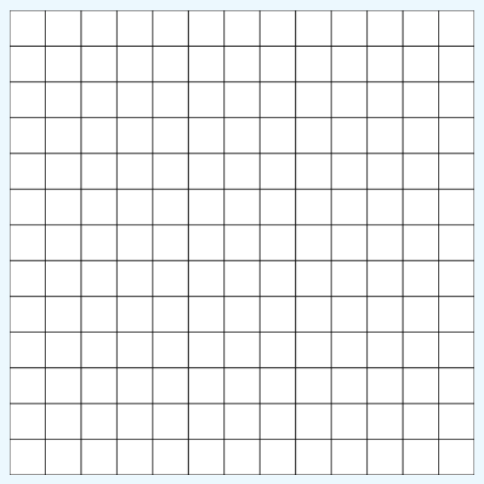
Algorithmic Approaches
Backtracking:
Try out all possible moves from a given position and backtracking when a move doesn’t lead to a solution.
Inefficient for large boards.
Divide and Conquer​
Solve the tour for smaller sections of the board independently and then combining them
Construct tours on most rectangular boards in linear time.

Slide 9
Algorithmic Approaches
Backtracking:
Try out all possible moves from a given position and backtracking when a move doesn’t lead to a solution.
Inefficient for large boards.
Divide and Conquer​
Solve the tour for smaller sections of the board independently and then combining them
Construct tours on most rectangular boards in linear time.
Warnsdorff's Rule
Move the knight to the square with the fewest onward moves, efficiently finding tours by reducing the branching factor of the decision process.
Notes:
Divide-and-Conquer Algorithms: This method involves solving the tour for smaller sections of the board independently and then combining them, which can constructs tours on most rectangular boards in linear time.
Warnsdorff's Rule: A heuristic that moves the knight to the square with the fewest onward moves, efficiently finding tours by reducing the branching factor of the decision process.

Slide 10
Algorithm Visualization &
Implementation

Slide 11
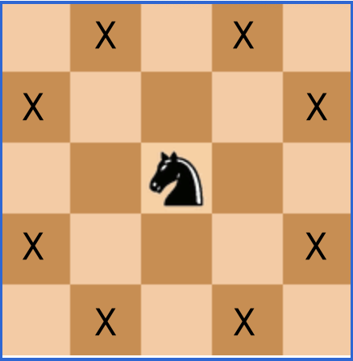
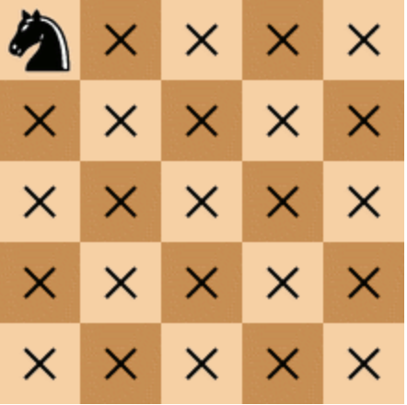
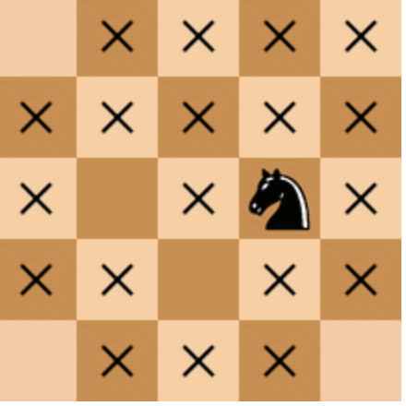
Backtracking Implementation
Exploration:
Place the knight on an empty cell & Explore all possible valid moves from that cell.
Recursively explore.
Base Case:​
If we have visited all cells on the chessboard. (Suppose we have 5*5 chessboard, then we must have 25-1=24 moves starting from 0).​
If this condition is met, we have found a valid solution, stop.​
Backtracking:​​
If the base case is not met, we backtrack.​​
This process continues until we find a solution or exhaust all possibilities.​
Python Library Used: PyQt5

Slide 12
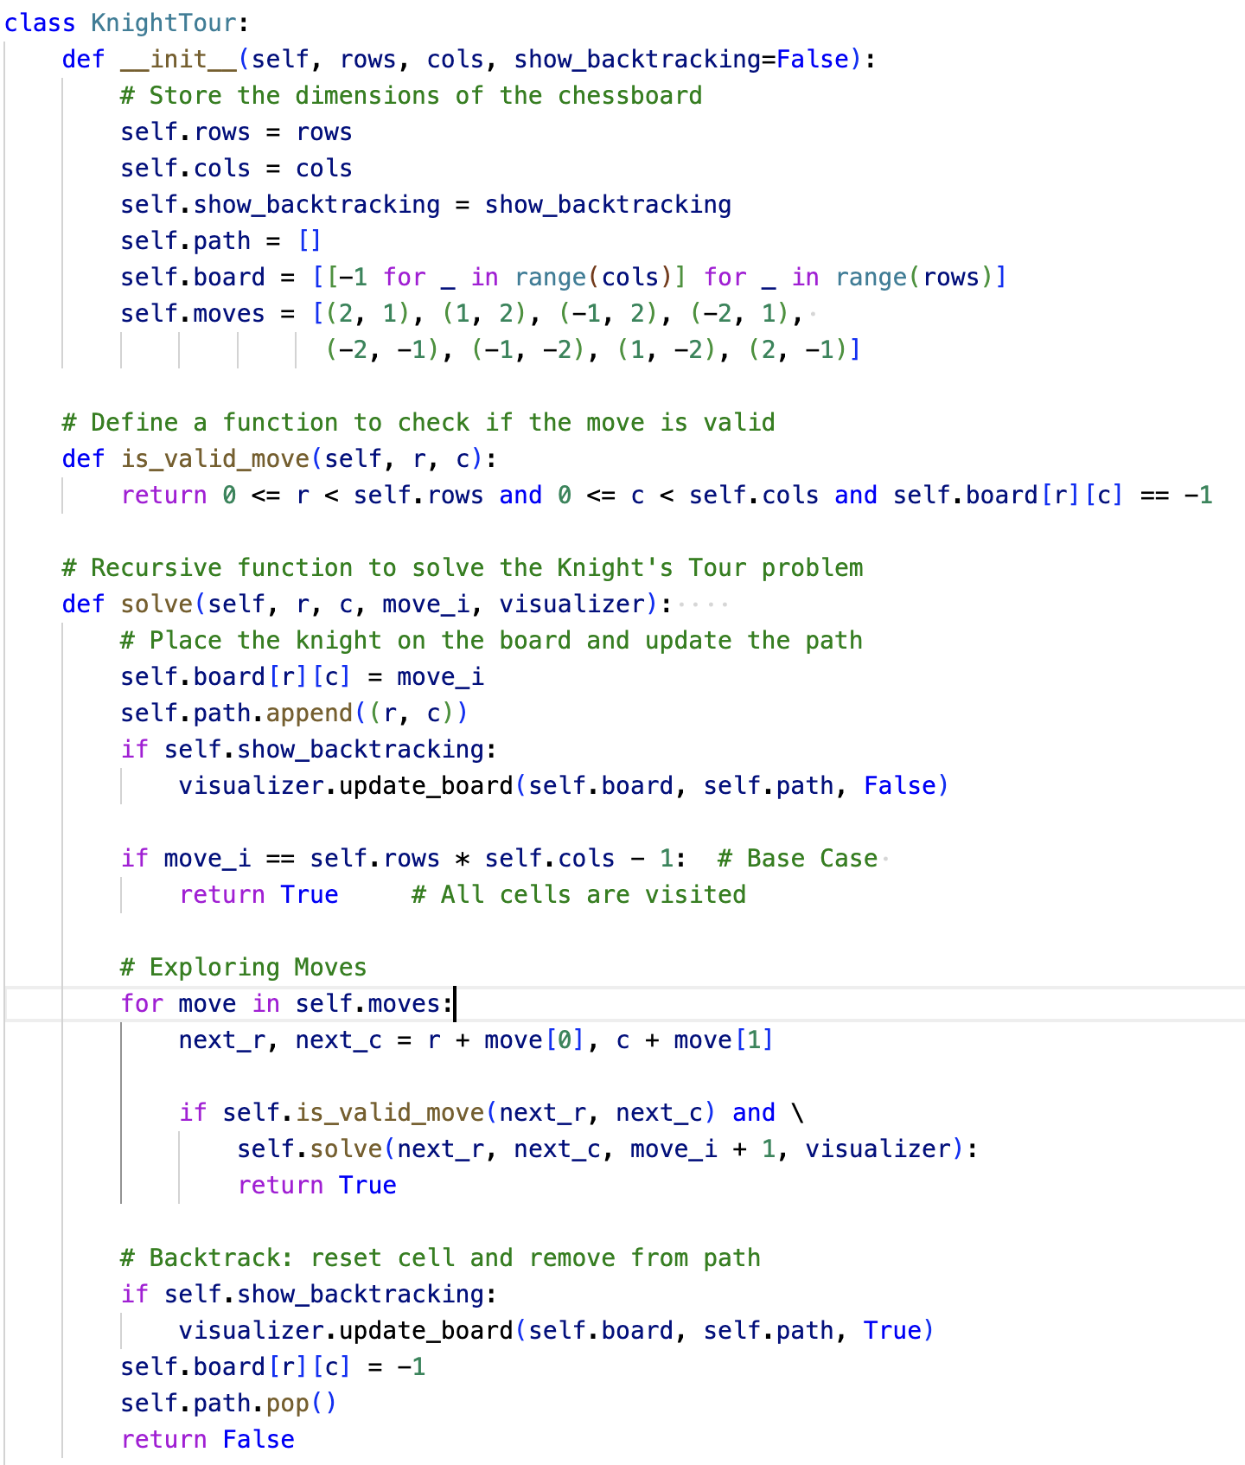
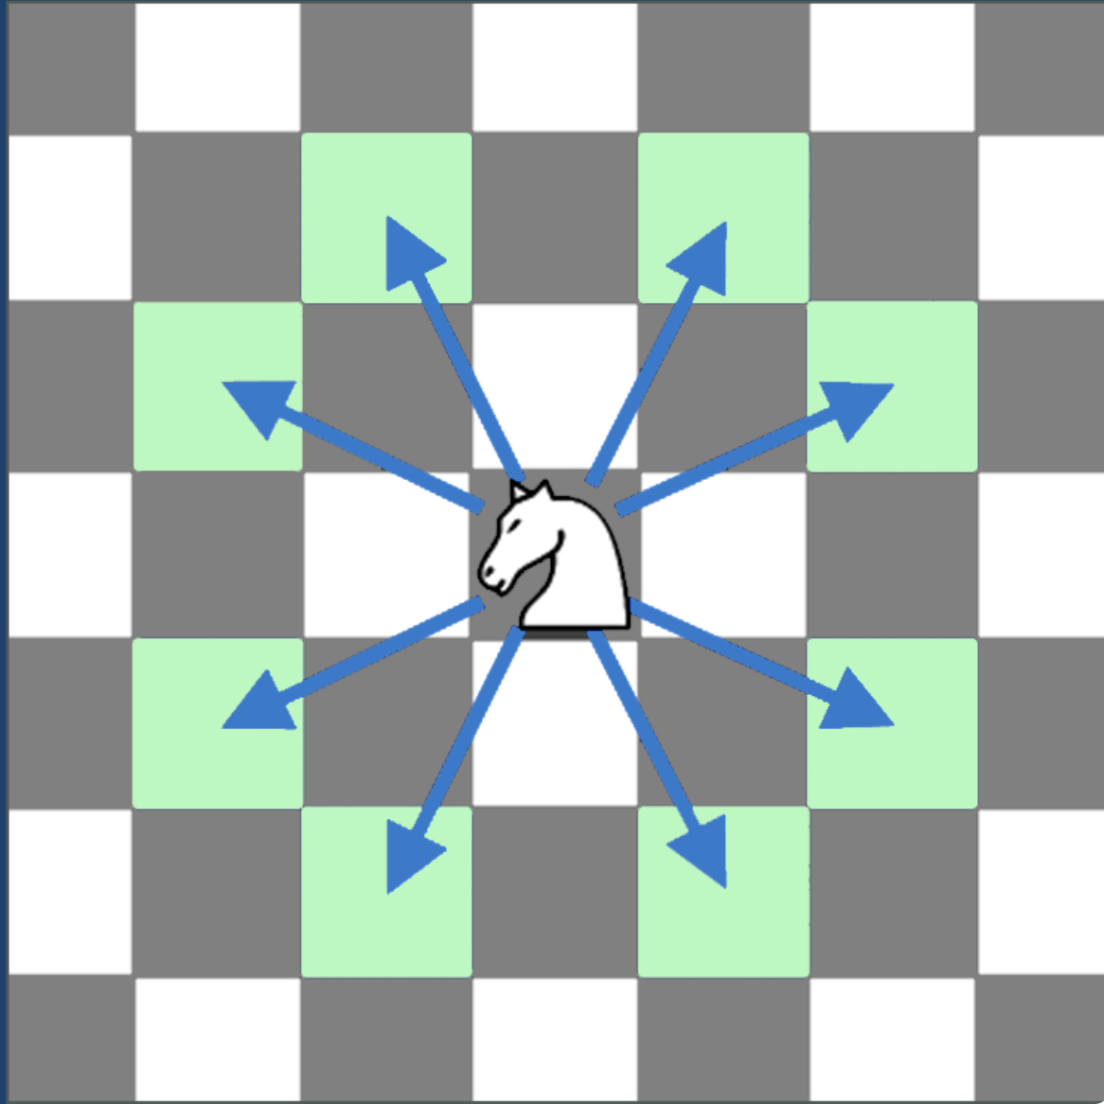
Implementation
Notes:
Now, let’s see the core logic behind implementing the knight tour’s problem using backtracking.
In the __init__ method we are initializing the parameters rows, columns, and backtracking Boolean flag.
The rows and cols parameters determine the dimensions of the chessboard.
show_backtracking is a flag that controls whether backtracking steps are visualized.
In the Board Initialization:
We create an empty chessboard represented by a 2D list (self.board).
Initially, the path is empty.
And, all cells are set to -1 to indicate they’re unvisited.
Possible Knight Moves (self.moves):
Next, we have defined the 8 possible moves a knight can make on the chessboard in L-shape.
Valid Move Check (is_valid_move method):
This method checks if a move is within the board boundaries and leads to an unvisited cell.
Recursive Solver (solve method):
This is the heart of the backtracking algorithm.
You start with a knight at position (r, c) and move_i representing the current move number.
If move_i reaches the total number of cells, you’ve found a valid tour (base case).
Otherwise, you explore all possible moves from the current position.
If a valid move is found, you recursively call solve with the updated position.
If no valid moves are left, you backtrack by undoing the last move.
If show_backtracking is True, you update the board and path during backtracking steps.

Slide 13
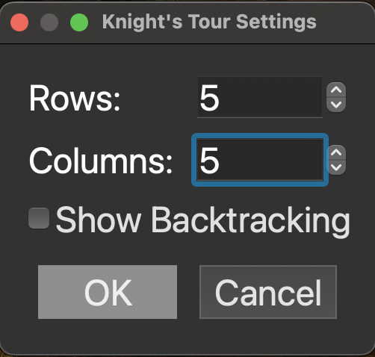
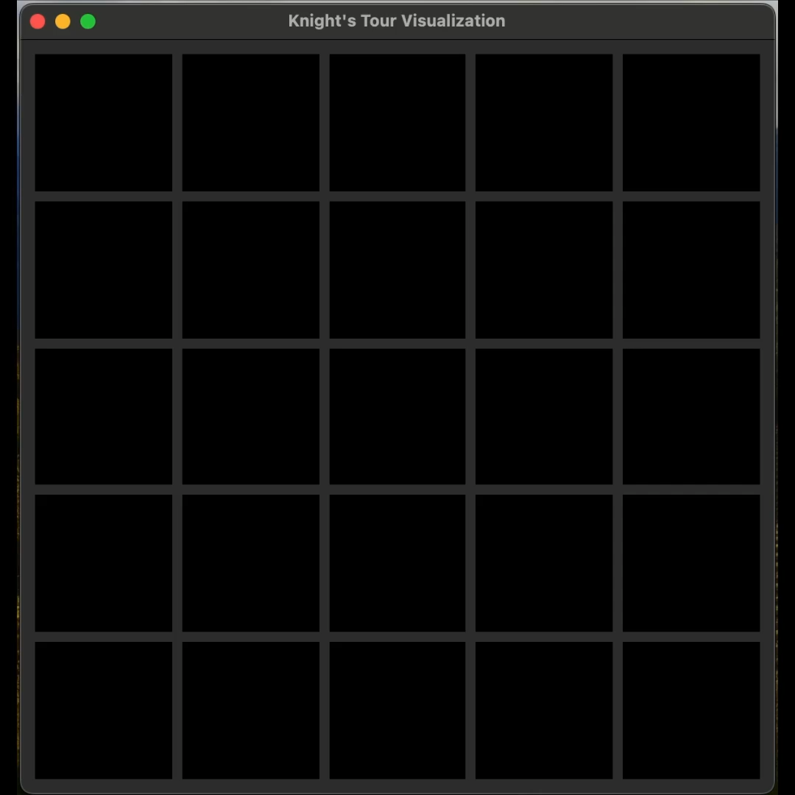
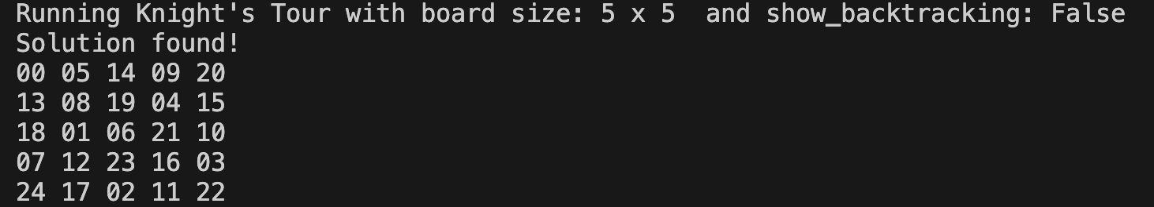
Algorithm Visualization w/o Backtracking Steps

Slide 14
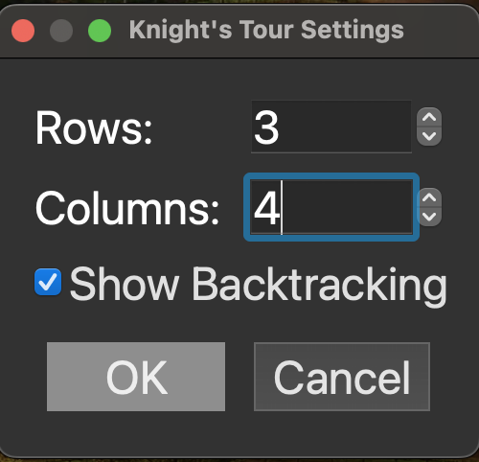
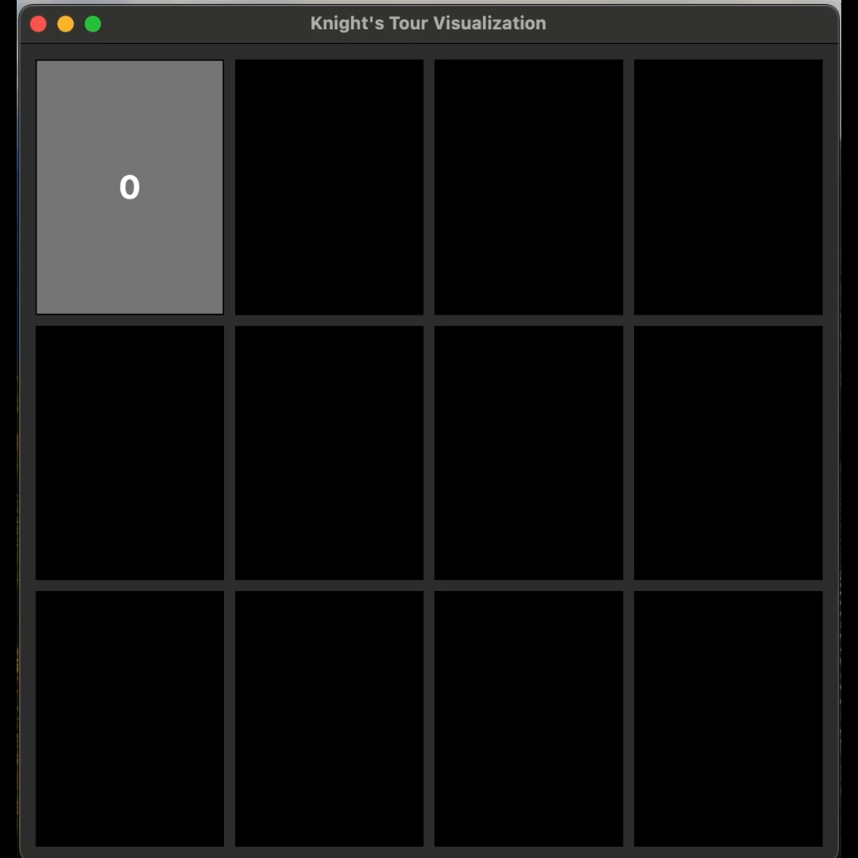
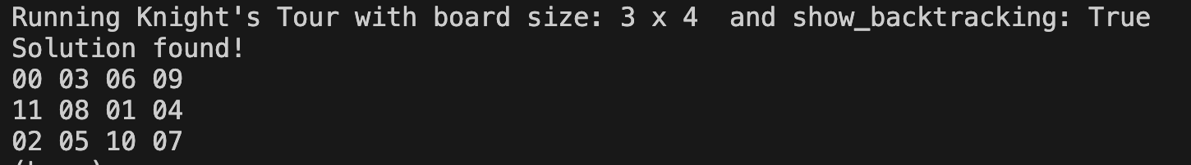
Algorithm Visualization With Backtracking Steps
Notes:
We also tried to implement Warnsdorff’s Algorithm which is a heuristic approach and optimizes the algorithm. It moves to the square with the lowest accessibility.

Slide 15
Time Complexity

Slide 16
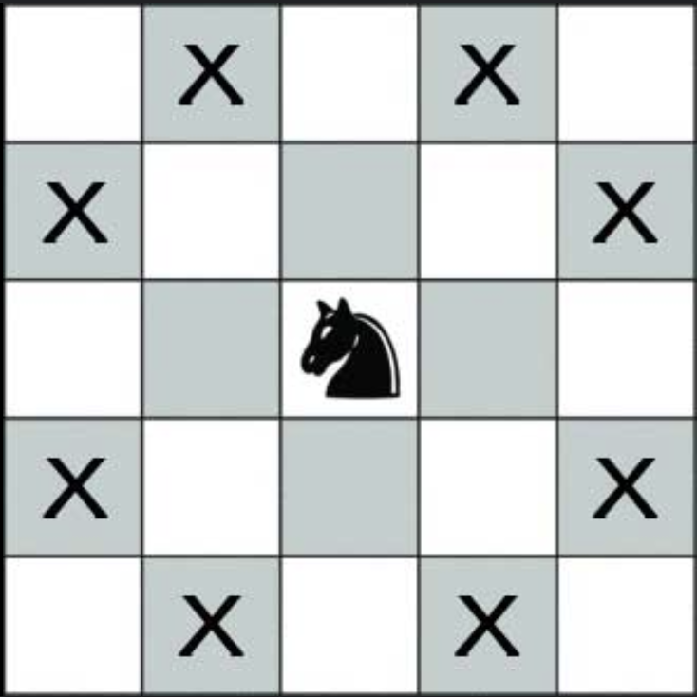
Time Complexity
Theoretical Analysis
Worst-case : ( O(8^(N * M) )
Explores 8 possibles moves
N * M cells to visit
Exponential Complexity due to increase in possible moves as the board size grows.
Best-case: ( O(N * M) )
Find valid tour quickly without backtracking

Slide 17
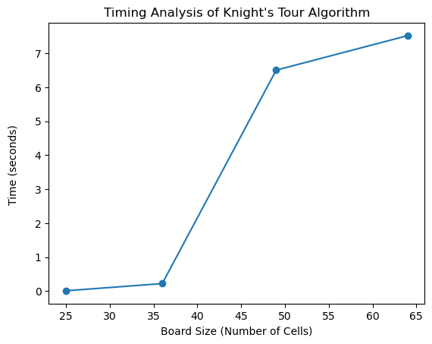
Time Complexity
Experimental Analysis:
Results show the algorithm's exponential nature.
The time jump from 5x5 to 6x6 and 7x7 shows rapid complexity growth.
Small increase from 7x7 to 8x8 suggests possible algorithmic efficiencies or earlier solution finding.
Board Size | Time (seconds)
5x5 | 0.01
6x6 | 0.22
7x7 | 6.42
8x8 | 7.36

Slide 18
Technical Challenges & Conclusion

Slide 19
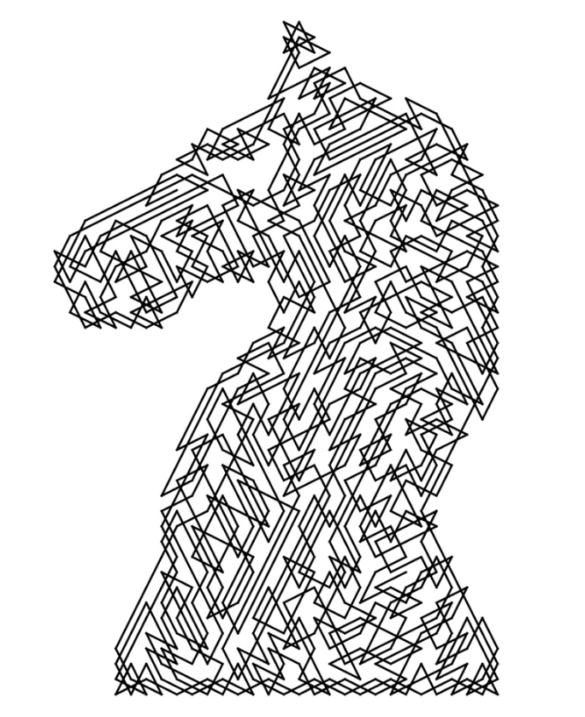
Technical Challenges
Slow Backtracking Steps
Memory Usage
Performance Issues
Edge Cases and Constraints
GUI Implementation & Knight Tour Visualization
Debugging and Avoiding Cycles
Notes:
• Slow Backtracking Steps: Backtracking in the Knight's Tour problem can be slow because it tries many paths before finding the correct one.
• Memory Usage: The Knight's Tour algorithm can use a lot of memory to keep track of visited positions on the board.
• Performance Issues: The performance can suffer due to the large number of possible moves, especially on larger chessboards.
• Edge Cases and Constraints: Handling edge cases in the Knight's Tour, like irregular board shapes and boundary conditions, can be challenging, especially when the knight moves across board edges.
• GUI Implementation & Knight Tour Visualization: Creating a graphical user interface to visualize the Knight's movements on the board can be challenging. While PyQt5 offers robust tools for GUI development, mastering its features can indeed be a challenging endeavor.
• Debugging and Avoiding Cycles: Debugging the algorithm and ensuring the knight doesn't revisit the same square (avoiding cycles) is crucial for correctness.

Slide 20
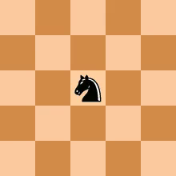
Conclusion
Boards larger than 8x8 are computationally intensive to solve.
Theoretical time complexity aligns with our experimental results.
There is an exponential increase in time complexity as board size grows.
Using Warnsdorff’s algorithm can enhance performance.

Slide 21
Reference
Image Encryption Scheme Based on Knight’s Tour Problem - Manpreet Singha, Ajay Kakkarb, Manjinder Singhc
https://github.com/XReaper95/knights-tour-python
https://runestone.academy/ns/books/published/pythonds/Graphs/ImplementingKnightsTour.html
https://www.geeksforgeeks.org/the-knights-tour-problem/#
https://www.tutorialspoint.com/data_structures_algorithms/knight_tour_problem.htm

Slide 22
Thanks
Anjali Haryani, Yuexin Ma, Payal Chavan, Mengyuan Liu

